Slide 1
The Problem
In rural parts of ABC nation only 30% of population is included in the formal financial system and situation becomes more tough in case of lower income group (daily wage workers/small stores/unorganized sector) where only 20% of people form a part of financial development. There is a clear need to boost financial inclusion programs especially in rural area.

Slide 2
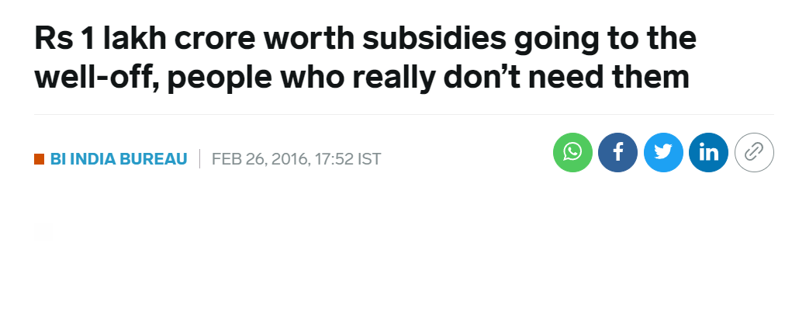
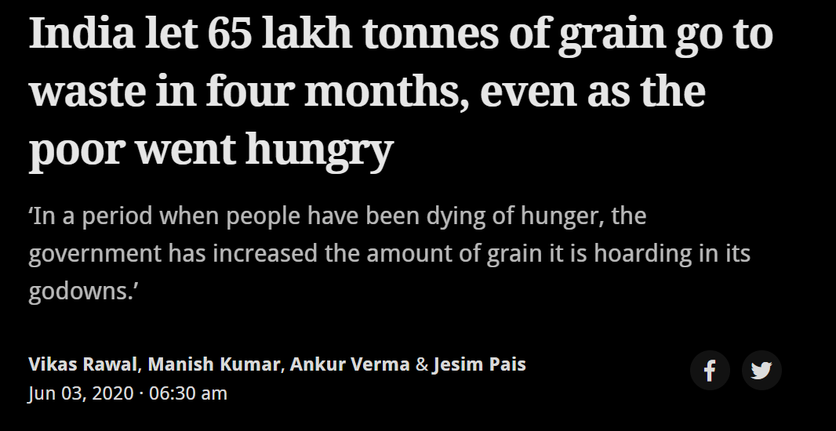

Slide 3
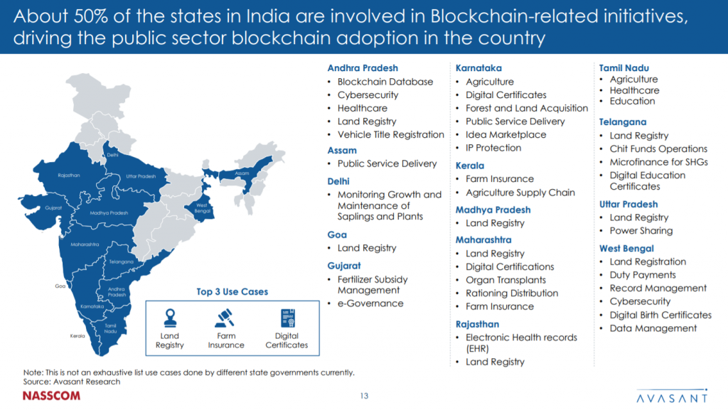

Slide 4
Introduction to Blockchain and its Applications
The application of blockchain can be numerous in various fields such as finance, microfinance, and digital identity. It also includes some business strategies that can be implemented using blockchain technology.

Slide 5
Technology Strategies
A "smart contract" is simply a program that runs on the Ethereum blockchain. It's a collection of code (its functions) and data (its state) that resides at a specific address on the Ethereum blockchain.
Smart contracts are a type of Ethereum account. This means they have a balance and they can send transactions over the network. However they're not controlled by a user, instead they are deployed to the network and run as programmed. User accounts can then interact with a smart contract by submitting transactions that execute a function defined on the smart contract. Smart contracts can define rules, like a regular contract, and automatically enforce them via the code.
Refugees and asylum seekers forced to leave their homes are often found without paperwork, posing problems for them and for legal authorities in proving their very existence.
Without paperwork, it's impossible to prove your date of birth, open a bank account, access government services, and even get a legal job. Blockchain technology offers an interesting solution here - being able to track an identity on a ledger via a unique, immutable and independently verified record provides new opportunities to tackle this problem.

Slide 6
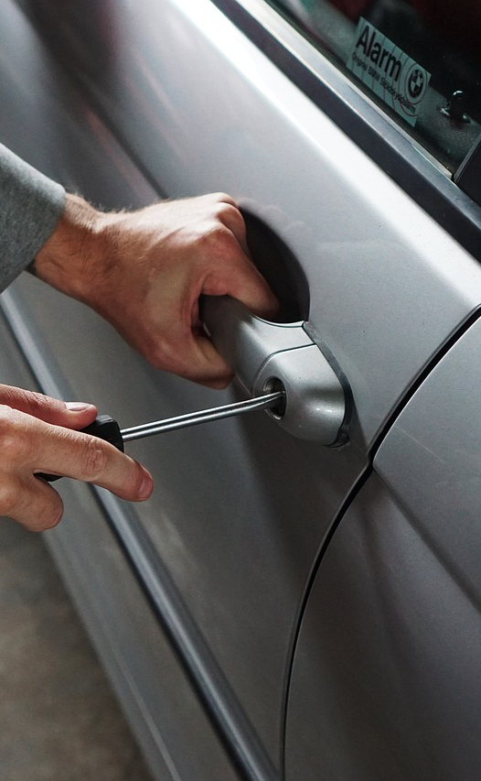
What is Blockchain?
- A decentralized and distributed ledger technology.
- Uses cryptography, consensus mechanics, and network protocols to create a tamper-proof and immutable record of all transactions.
Photo by Pixabay

Slide 7

Smart Contracts
- Self-executing contracts with the terms of the agreement between buyer and seller being directly written into lines of code.
- Can be used to automate and enforce the terms of microfinance agreements.
Photo by Pixabay

Slide 8

Microfinance
- Blockchain-based microfinance platforms can provide access to financial services to people who have traditionally been excluded from the traditional banking system.
- Enables secure, transparent, and cost-effective transactions.
- Can help reduce the cost of providing financial services to the unbanked population.
Photo by Pixabay

Slide 9

Digital Identity
- Blockchain-based digital identity systems can provide a secure and tamper-proof way to establish and verify identities.
- Helps people access financial services, healthcare, and other essential services that require proper identification.
Photo by Pixabay

Slide 10
Operating Model
This presentation explains the operating model of a blockchain-based financial inclusion program in India. The program aims to provide better access to financial services to the poor sections of the rural society.

Slide 11

Register and Verify Eligibility
- Individuals register themselves by providing personal and demographic information.
- Information is verified for accuracy and eligibility.
- Blockchain card is issued once verified.
Photo by Pixabay

Slide 12

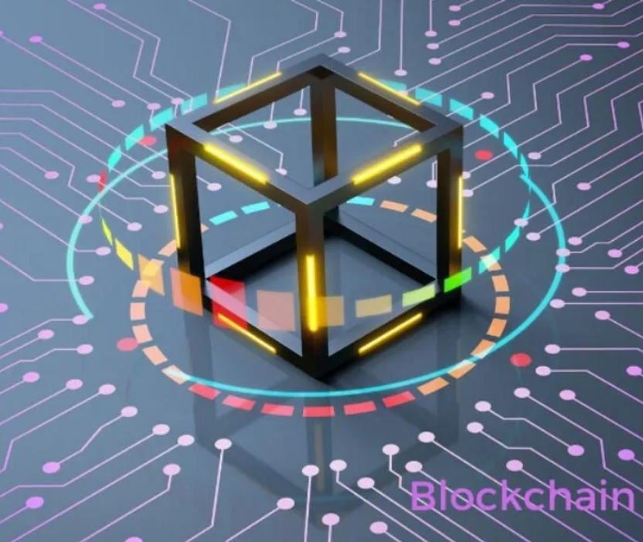
Distribution of Blockchain Card
- Distributed physically through community outreach programs, govt. agencies, or local banks.
- Ensures it reaches poor sections of the rural society.
- Kiosks in rural areas enable access to financial services.
Photo by Pixabay

Slide 13

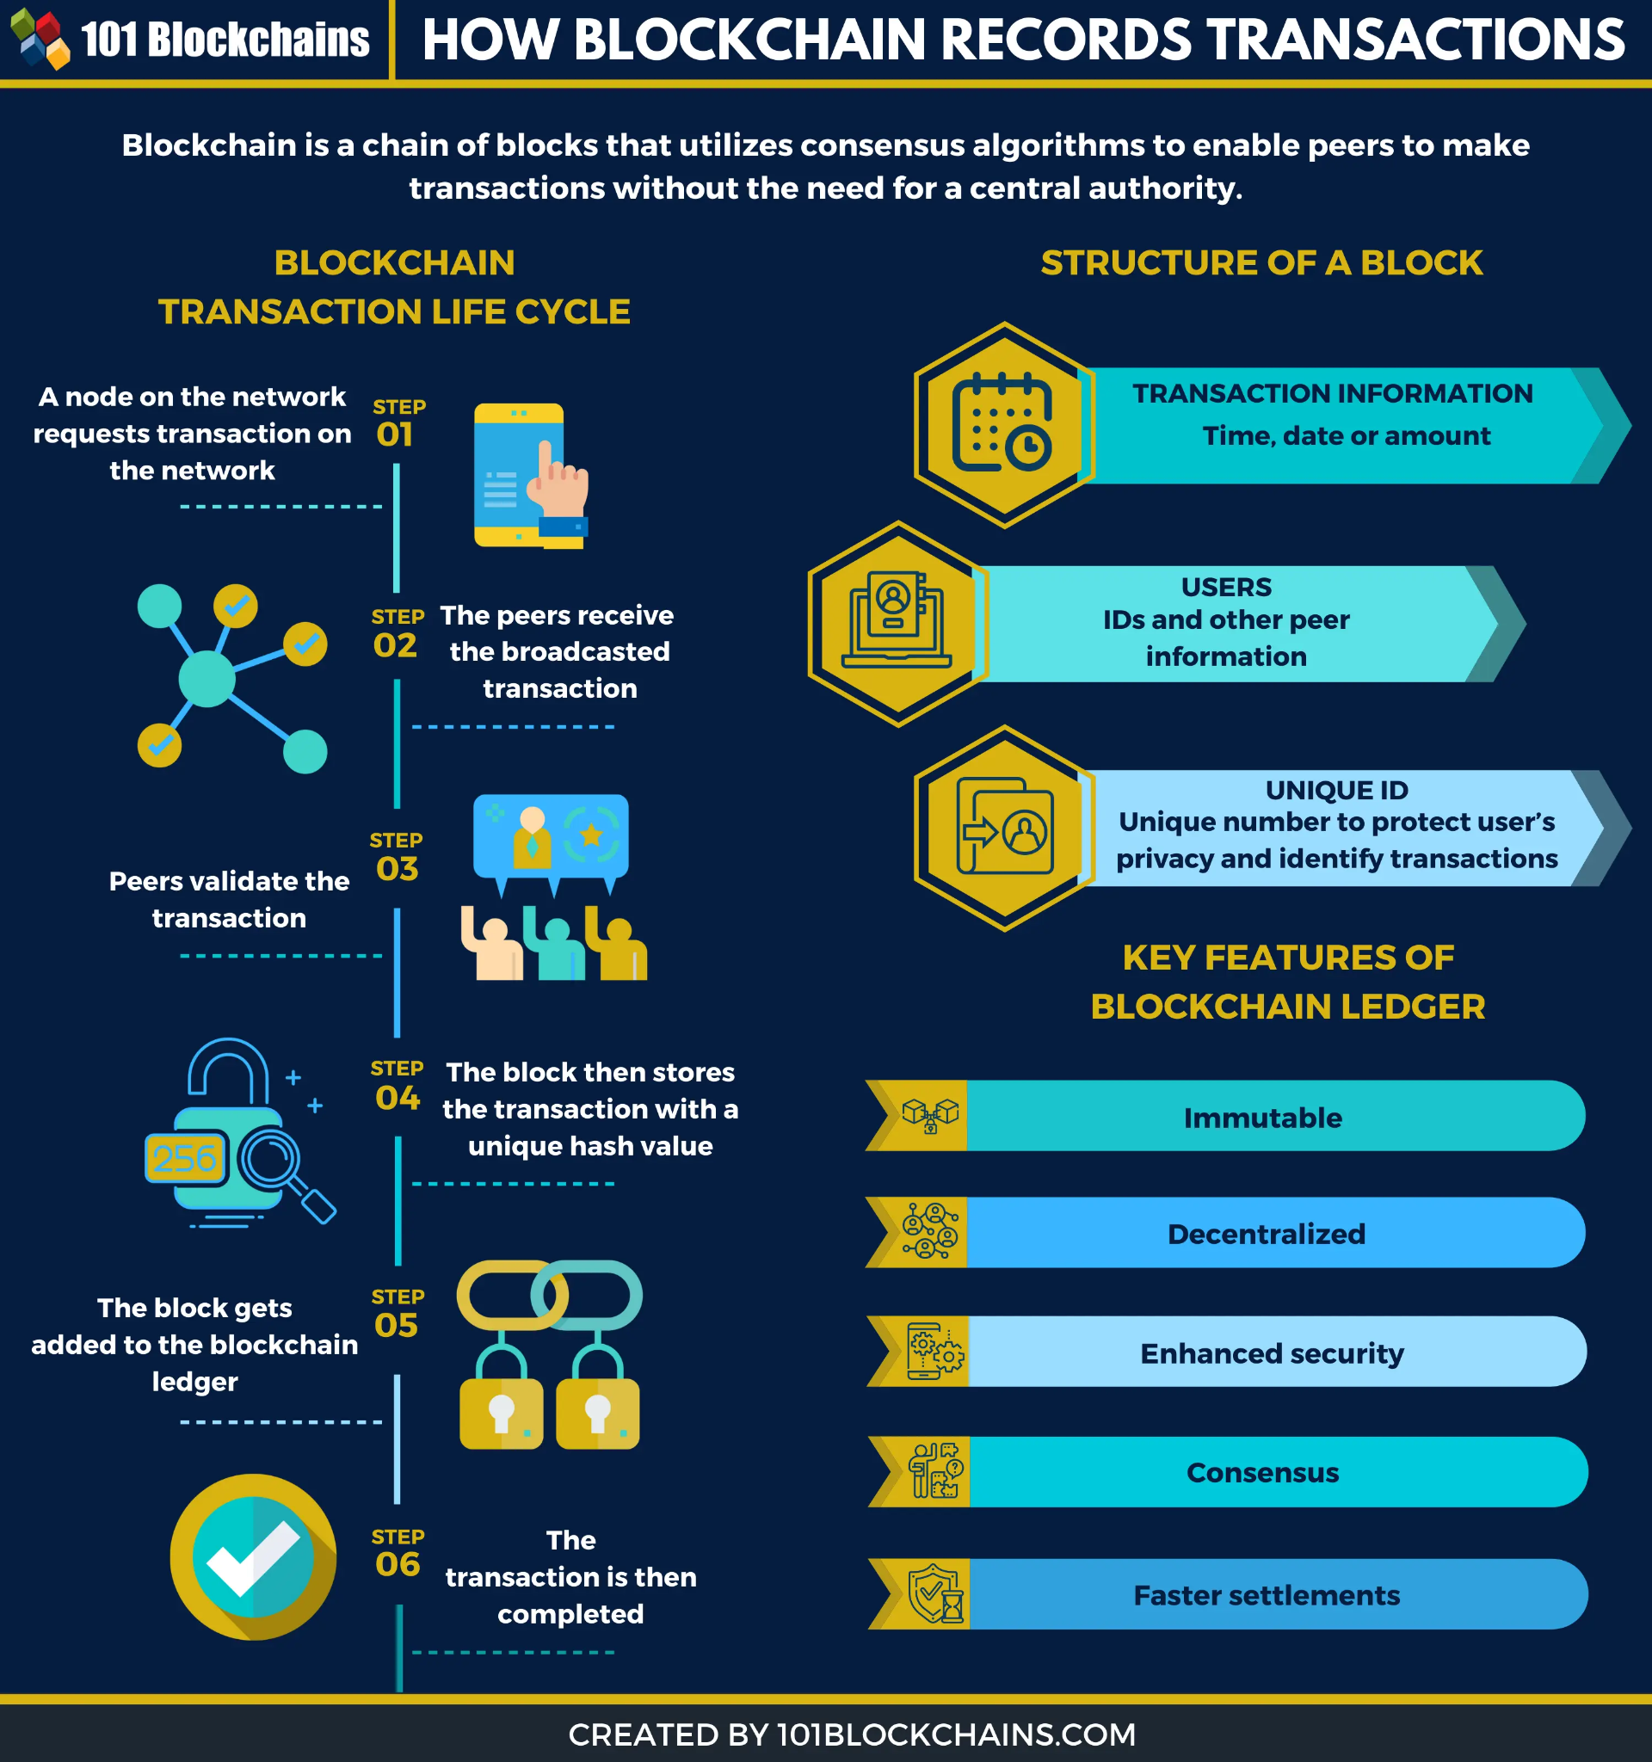
Facilitating Transactions
- Partner banks facilitate transactions and provide liquidity to the system.
- Individuals' repayment history reflected on blockchain card.
- Score increases with timely repayment, enabling better access to financial services.
Photo by Pixabay

Slide 14
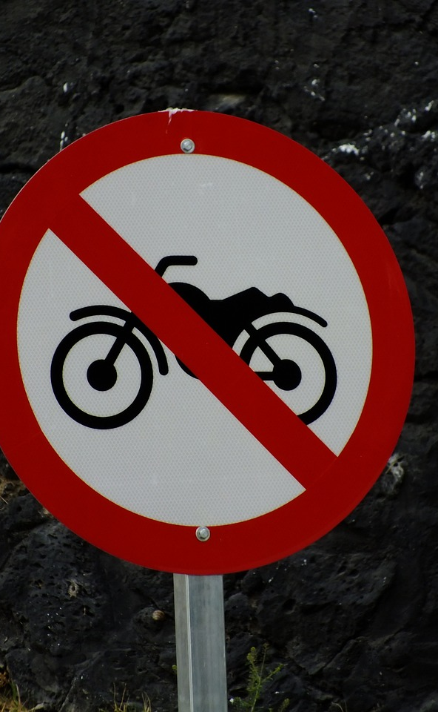
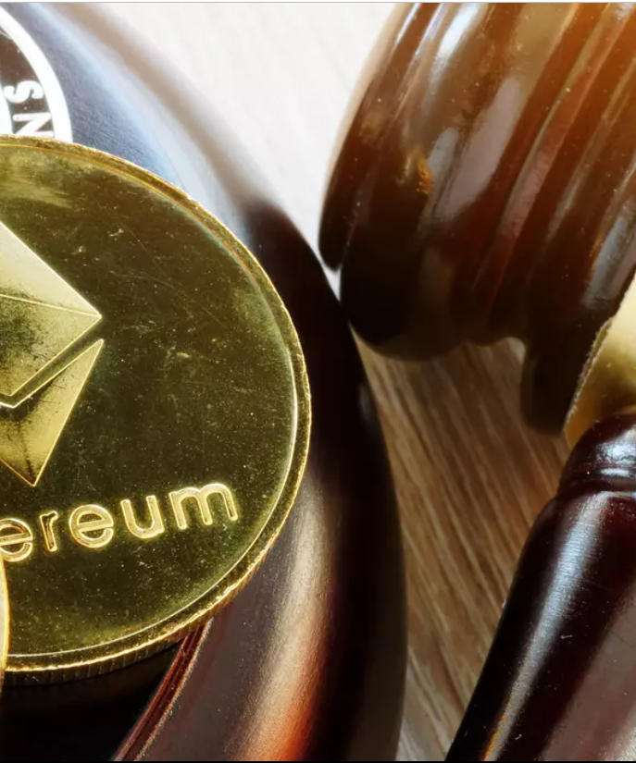
Compliance with Regulatory Requirements
- Program needs to comply with local regulatory requirements.
- Ensures sustainability and capability to scale.
Photo by Pixabay

Slide 15

Immutability of Blockchain Technology
- Once data is recorded on the blockchain, it cannot be altered or deleted.
- Ensures accuracy and integrity of information.
Photo by Pixabay

Slide 16

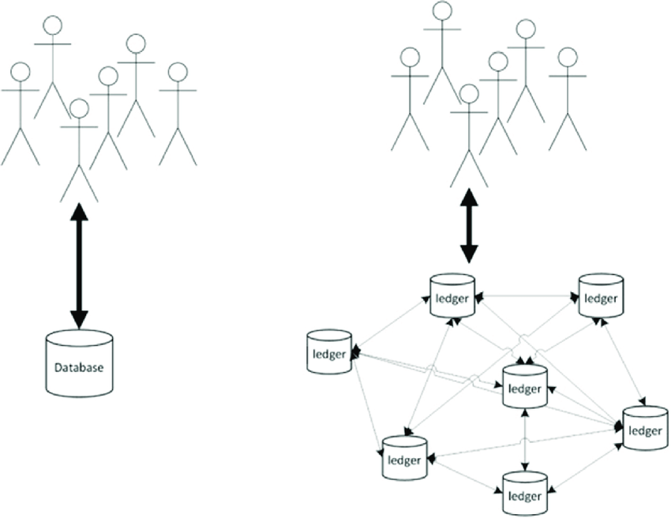
Storing and Verifying Information
- Blockchain used to store and verify
individuals' personal and financial
information.
- Prevents false information from being
added to the system.
Photo by Pixabay

Slide 17
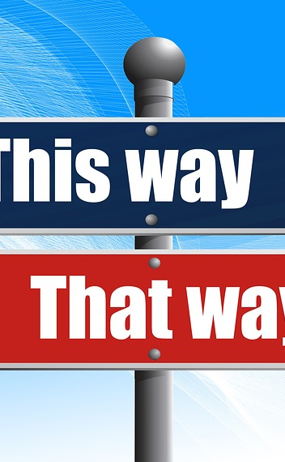
Flagging False Information
- Discrepancies in information are immediately flagged as false and rejected.
- Ensures only accurate information is recorded on the blockchain.
Photo by Pixabay

Slide 18
Ensuring Eligibility
- Eligibility for benefits is verified based on the information recorded on the blockchain.
- Ensures only eligible individuals receive the benefits.

Slide 19
Business Strategies

Slide 20

- High client acquisition through the distribution of complimentary cards.
- Low interest rates on loans taken out by the lowest income groups.
- Offering the community specialised retail items including commercial account analysis, fee refunds, cash awards, and customised rate incentives.
Photo by Pixabay

Slide 21
- Boosting the credit scores of those having a history of paying their bills on time.
- Insurance services can be made available to people easily as the blockchain ledger contains all their information.
- Engage the audience and solicit input to create reference resources.
Photo by Pixabay

Slide 22
Revenue Model

Slide 23


- Income derived from loan interest
- Income from insurance premiums paid up by rural
people
- Government grants received for the improvement of the rural, low-income inhabitants of ABC nation
- Transaction fees of 0.1% for transactions over 10,000 INR
Photo by Pixabay

Slide 24
Conclusion
- Blockchain-based financial inclusion program can ensure accuracy and integrity of information.
- Can provide financial access to the poor sections of the Indian rural society.
- Will result in financial inclusion for all societal groups in the rural areas of ABC.
- Enable access to low cost credit.
- Will promote technology use and raise awareness of fintechs among ABC's rural residents.
Photo by Pixabay

Slide 25
Thank you. Please feel free to ask any questions. 😄

